Slide 1

-----------------------------------------------------------------------------------------------------------------------------------------------
SHOPPING MANAGEMENT SYSTEM
basic
------------------------------------------------------------------------------------------------------------------------------------------------
< / >
Name | Contribution
MD SOHANUR RAHMAN SOHAN | Start Shop,(main+Check Discount,Contact)window, check 1,slide
MD REDOANUR RAHMAN | Login,Registration process ,user.txt,photo adding,checking 2
SABBIR HOSSEN TAPADAR | Bill window, get bill ,product cart popup, checking 3
MOHIMIN SHIKDAR | Start process,add cart,Splash Screen,image collect checking 4

Slide 2
DESCRIPTION
This is our New Shop V2 is a Java-based desktop application designed to deliver an interactive and user-friendly shopping experience. Built using Java Swing, it features a robust system that allows users to browse and shop across categories such as Grocery, Electronics, Sports, and Medicine. The application includes a user authentication system for registration and login, with distinct roles for customers and administrators. Customers can add items to their cart, view product details, calculate totals, and generate detailed bills with an eligibility check for discounts. Administrators have access to placeholder features for managing users, products, and reports. The application showcases essential software development concepts, including Object-Oriented Programming, event-driven programming, GUI development, and file-based data management. Developed by MD Sohanur Rahman Sohan, Sabbir Hossen Tapadar, Redoanur Rahman, and Mohimin Shikdar, this project demonstrates a modular and practical approach to designing shopping applications, emphasizing seamless multi-window navigation and efficient cart management through the use of Java's ArrayList.
Page 1

Slide 3
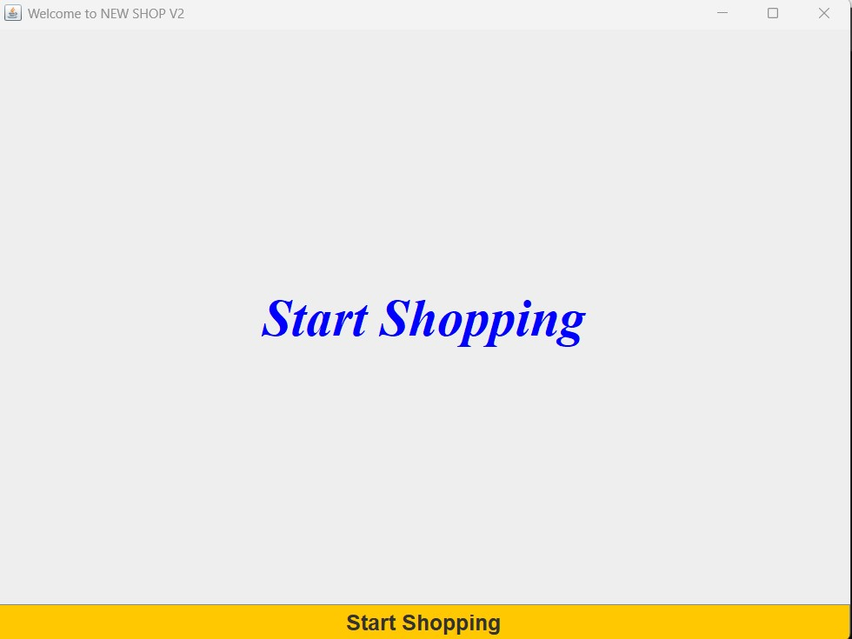
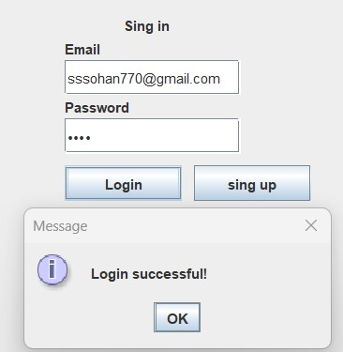
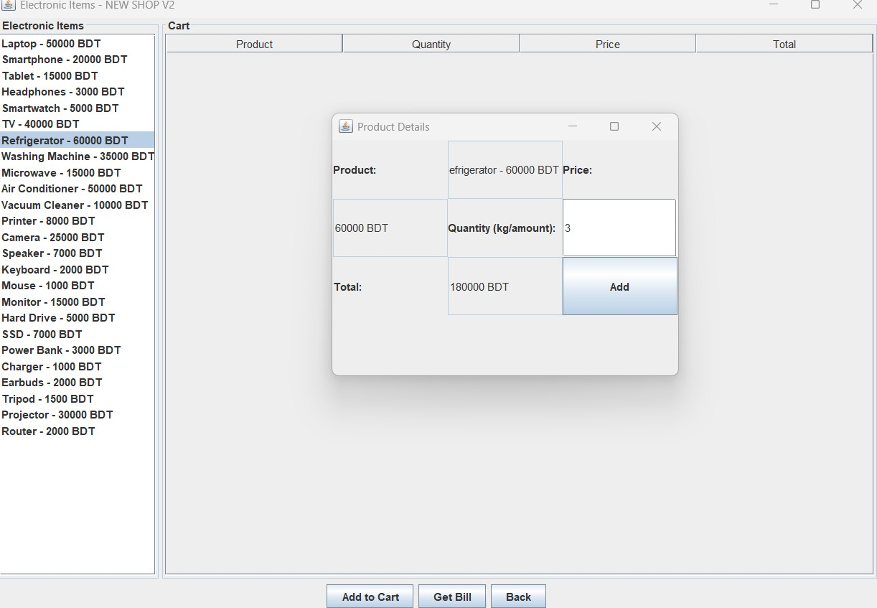
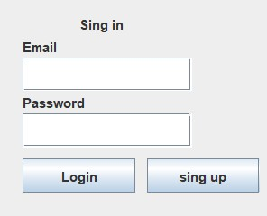
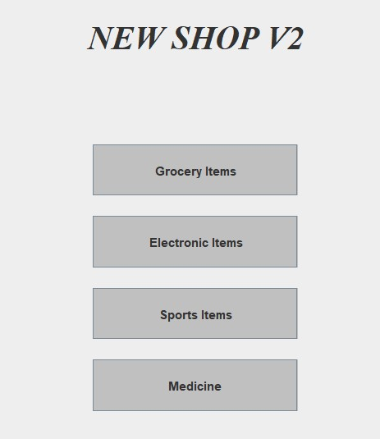
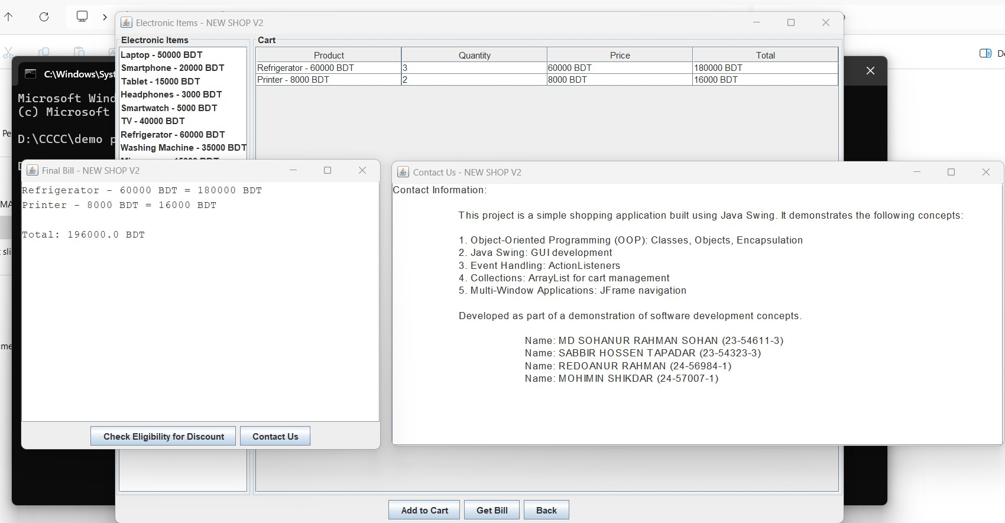
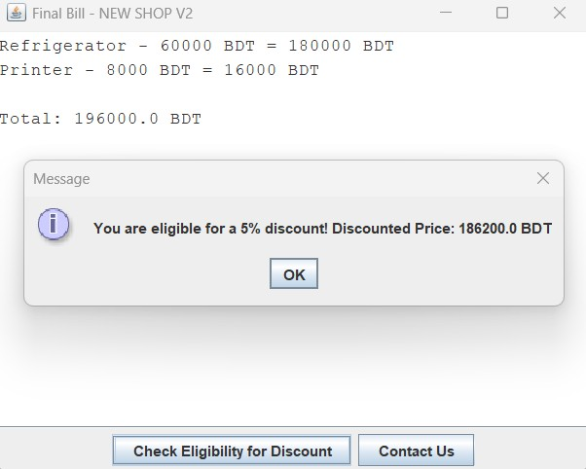
SNAPSHOTS & FEATURES
Page 2

Slide 4
inheritence
Main Window
Category
Contact
Bill Window
Splash Screen
Page 3

Slide 5
polymorphism
Action performed
registration
management
Main Window
Action Listener
interface
Action
Listener
Page 4

Slide 6
Lackings
No use of advance OOP concepts like design patterns.
Polymorphism has used in limited or primarily
Limited Admin Functionality
No Database Integration
Page 5

Slide 7
THANK YOU

